Slide 1
Lin, Pey-Chwen
1990 ~ 1993
Women’s Interpretation Series
1995 ~ 2009
Patriarchal Decontruction Series

Slide 2
Art Statement
Pey-Chwen Lin’s Art Statement of Women’s Interpretation
by Pey-Chwen Lin
In early stage, abstract painting is used to release my perplexity being a woman artist when I have completed the series of painting titled “Female Interpretation" and "Chrysalis". Due to self exploration and narration of this stage, female perplexity has been gradually clarified. During advanced study period in Australia, I have studied many feminist art theories, and presented many artworks from "female viewpoint", such as the works of "Antithesis and Intertext-The Issue of Women's Position", "Black Wall, Inside and Outside Window", and "Safety Nest", etc. However, I also perceived that "female issue" in fact can not be separated from the social and culture issue shared by both genders of male and female. Women shall participate in related discussion and creation in a more positive way. Therefore, my works started to concern about the social and history issues shared by whole human race, such as criticism of the historical event of Taiwan "Regards to the Authorities Making 228 Great Historical Tragedy in Taiwan", study on humanity "Reality and Falsehood - Maze Series", review on complex mass media "Complexity and Thought Origin”, and suspicion on the entire educational system "Classical Work", etc. Therefore, I am willing to concern and review various situations occurring to my own culture and community with artworks- it may be related to broad issues for both genders of male and female, society, politics and all human races.
Exhibitions
SPACE II Gallery. Taipei , 1990
Tainan Culture Center ,Tainan , 1990
SPACE II Gallery. Taipei, 1991
National Art Education Museum, Taipei , 1991
Taipei Fine Art Museum, Taipei , 1991
Dimension Art Center, Taipei ,1991
Capital Art Center, Taichung ,1992
Tainan Culture Center, Tainan , 1992
Holly Gallery, Taipei, 1992
Up Gallery , Kaohsiung , 1992
GO GO Gallery, Tainan, 1992
SPACE II Gallery. Taipei , 1992
SPACE II Gallery. Taipei , 1993
Home Gallery ,Taipei, 1993
UP Gallery ,Taipei, Kaohsiung ,1993
“Women’s Interpretation”， National Taiwan Museum of Arts,1993
Capital Art Center,Taichung,1993

Slide 3
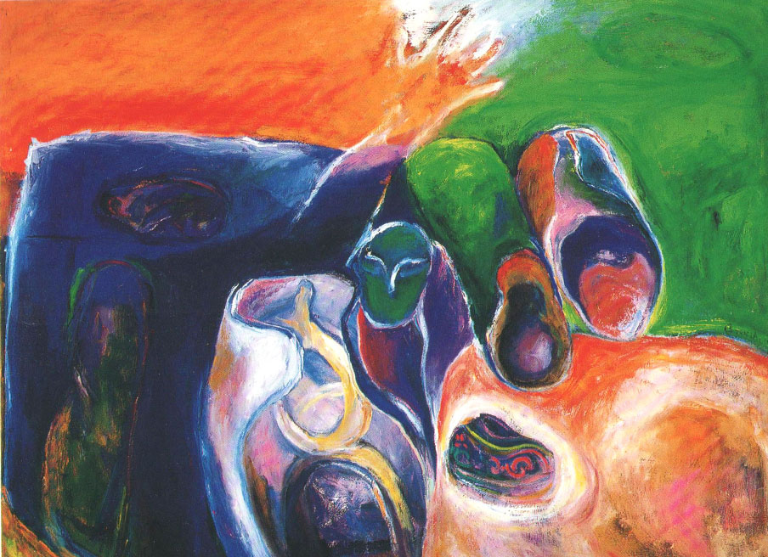
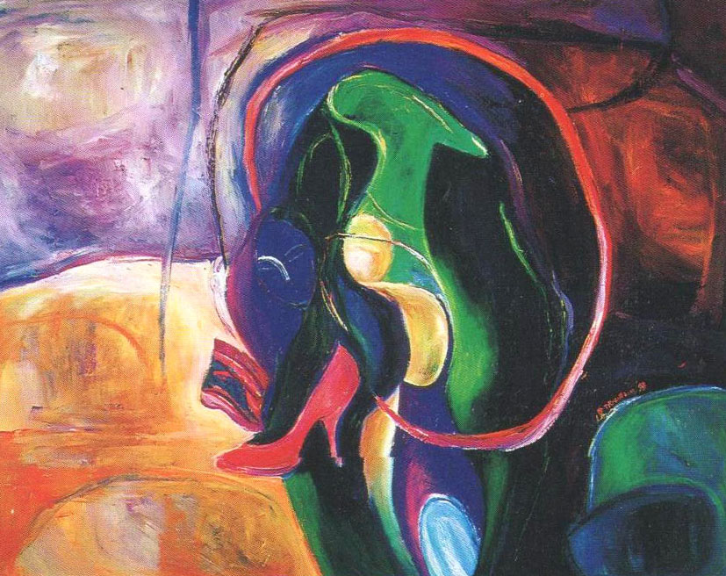
蛹系列
The Chrysalis Series(1993)
http://www.linpeychwen.org/the-chrysalis-series1993/
油畫
117X91cm/50F

Slide 4
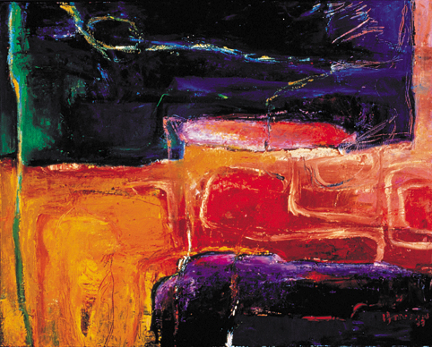
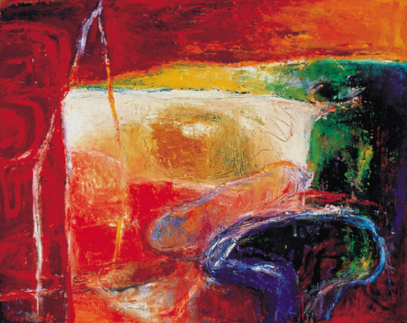
蛹系列
The Chrysalis Series(1994)
http://www.linpeychwen.org/the-chrysalis-series1993/
油畫
117X91cm/50F

Slide 5
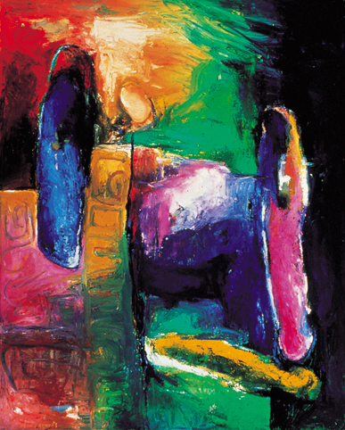
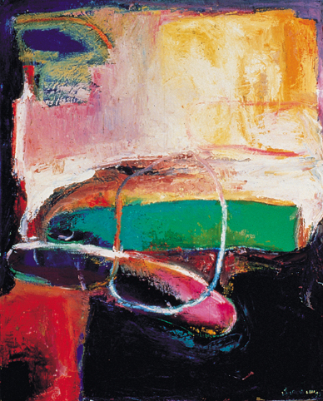
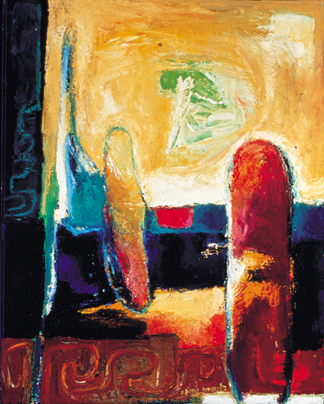
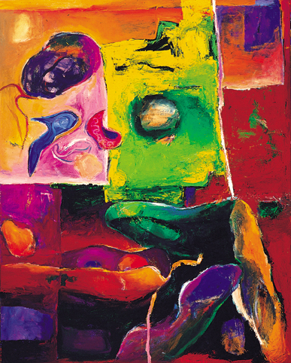
蛹系列
The Chrysalis Series(1994)
油畫
117X91cm/50F

Slide 6
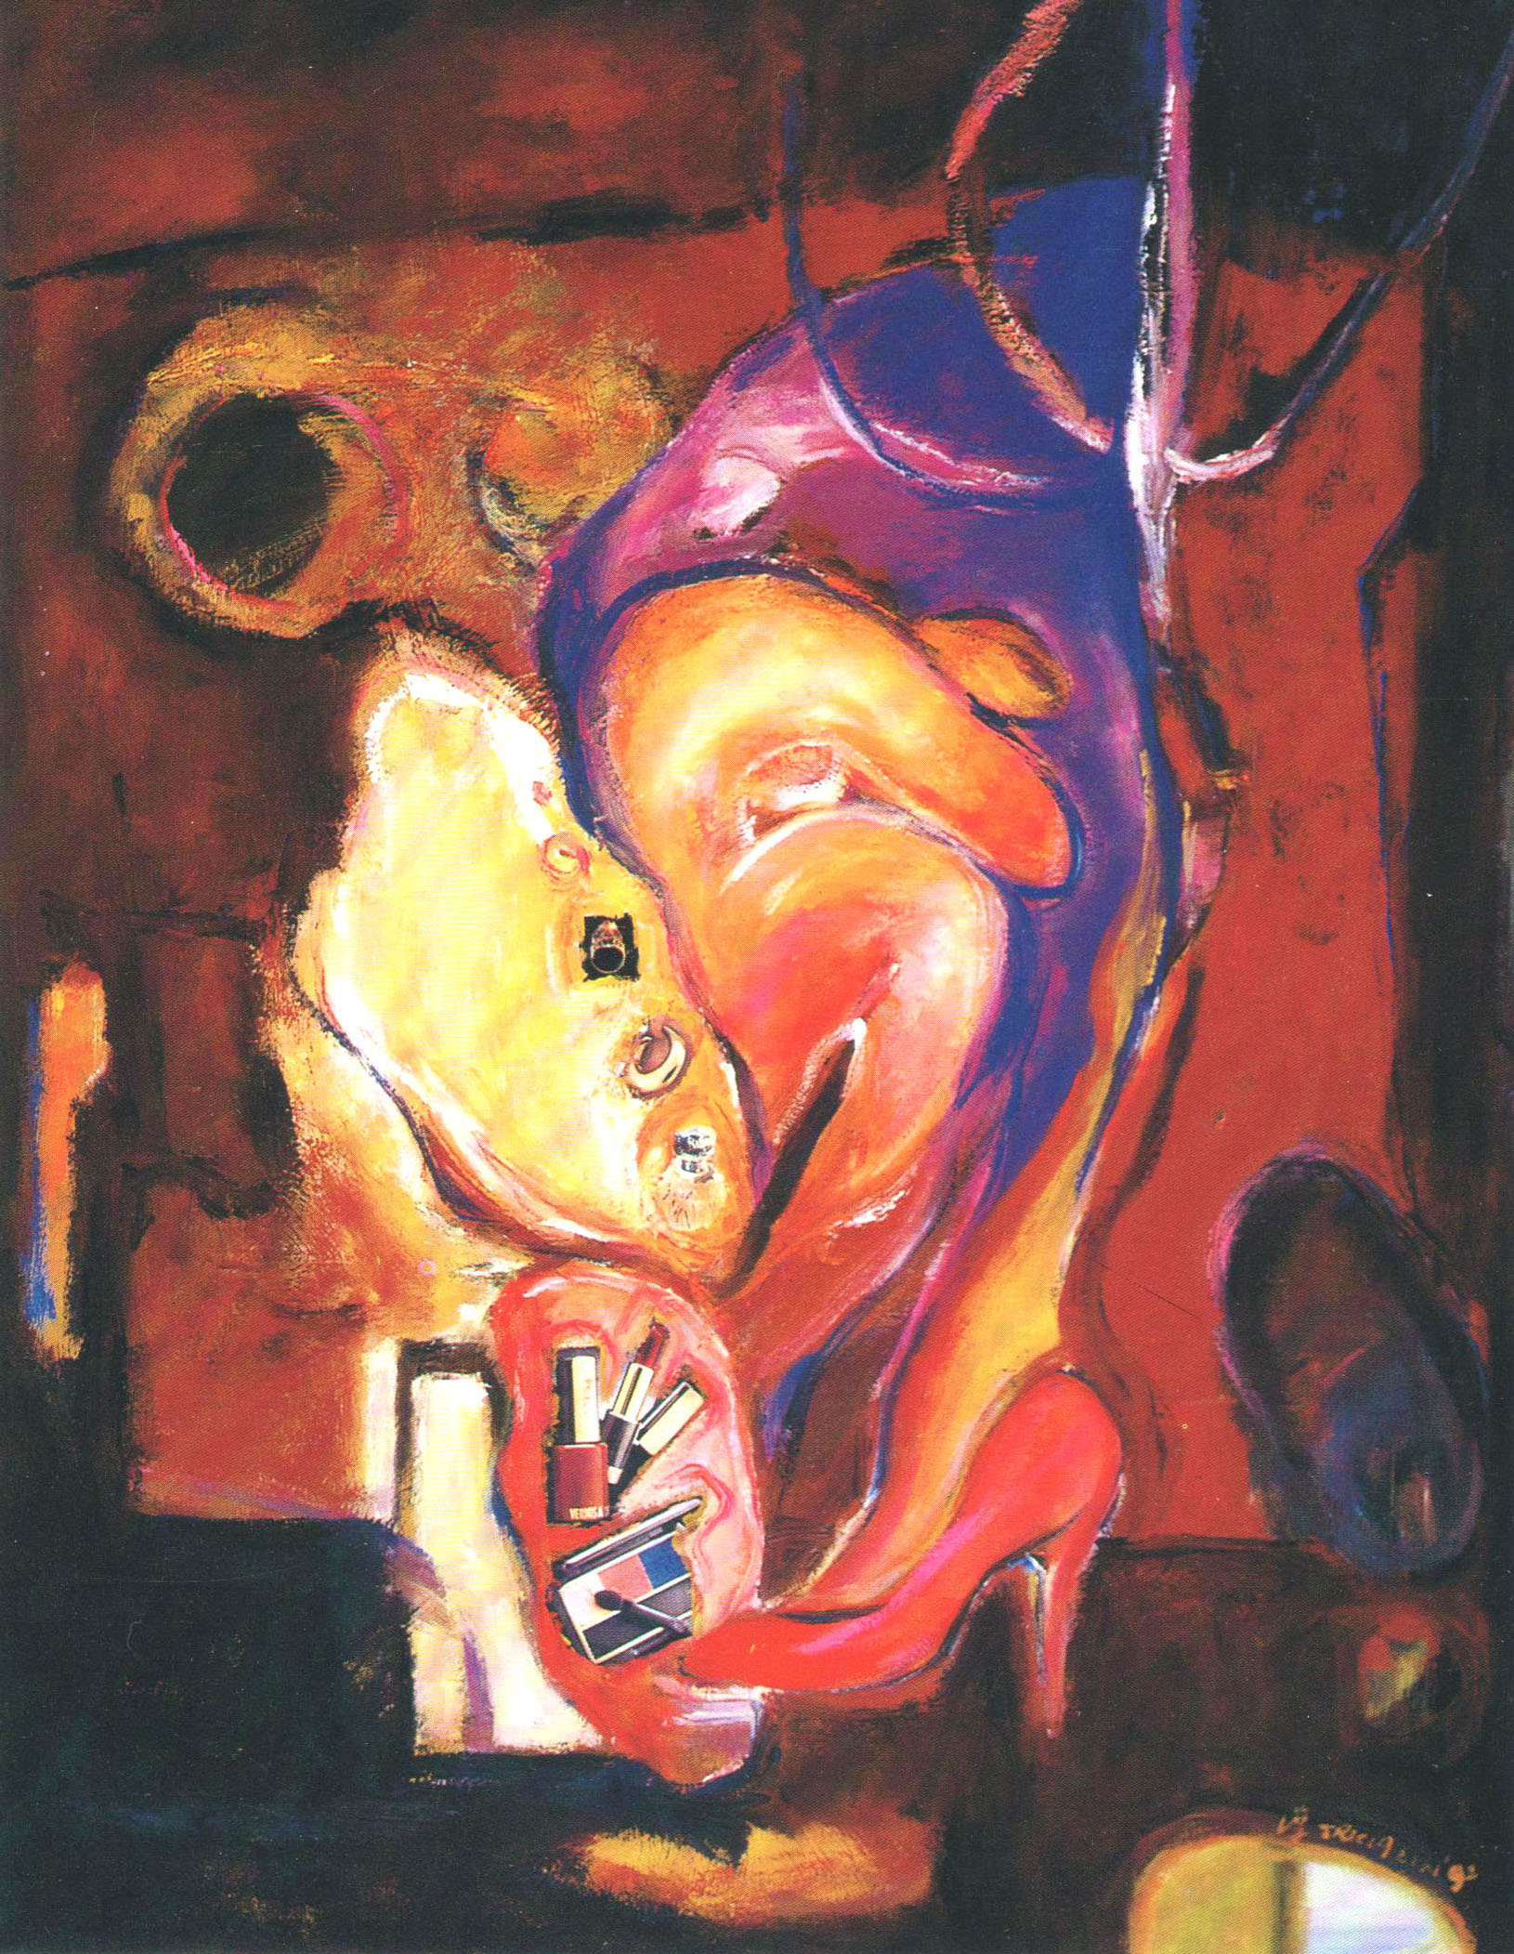
文明誘惑系列
The Temptation Series (1992)
http://www.linpeychwen.org/the-temptation-series1992
油畫
130X162cm/100F

Slide 7
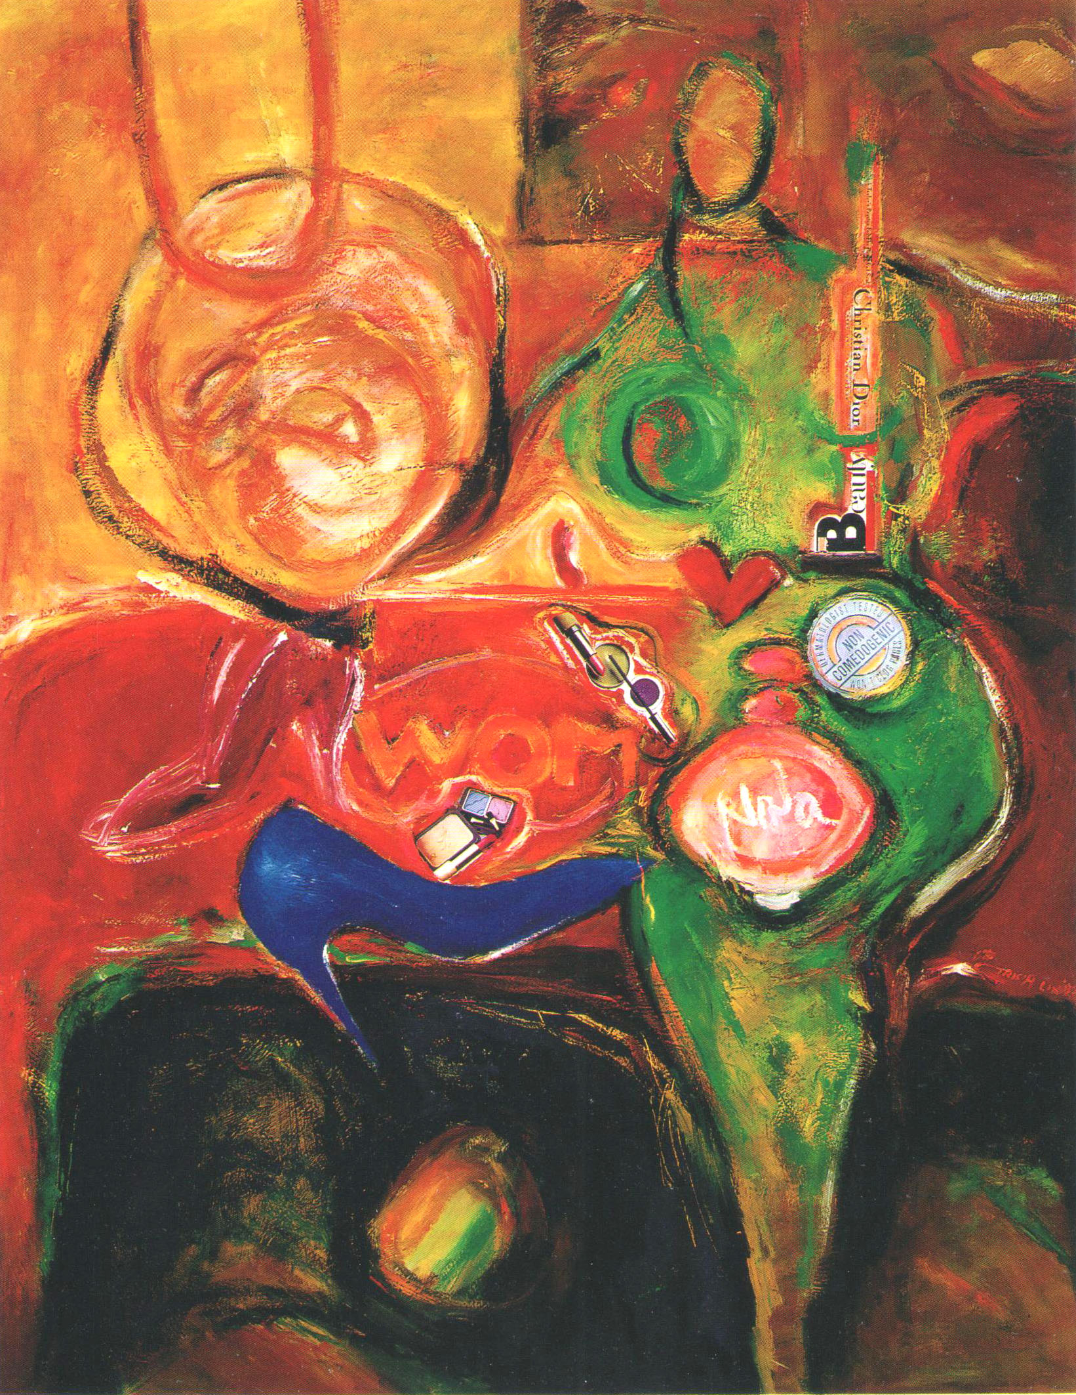
文明誘惑系列
The Temptation Series (1992)
http://www.linpeychwen.org/the-temptation-series1992
油畫
130X162cm/100F

Slide 8
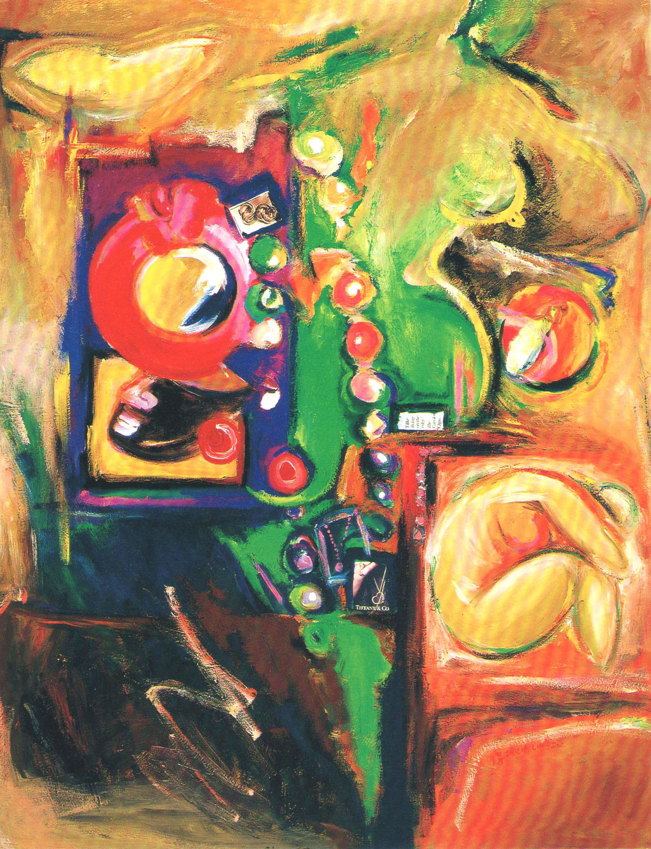
文明誘惑系列
The Temptation Series (1992)
http://www.linpeychwen.org/the-temptation-series1992
油畫
130X162cm/100F

Slide 9
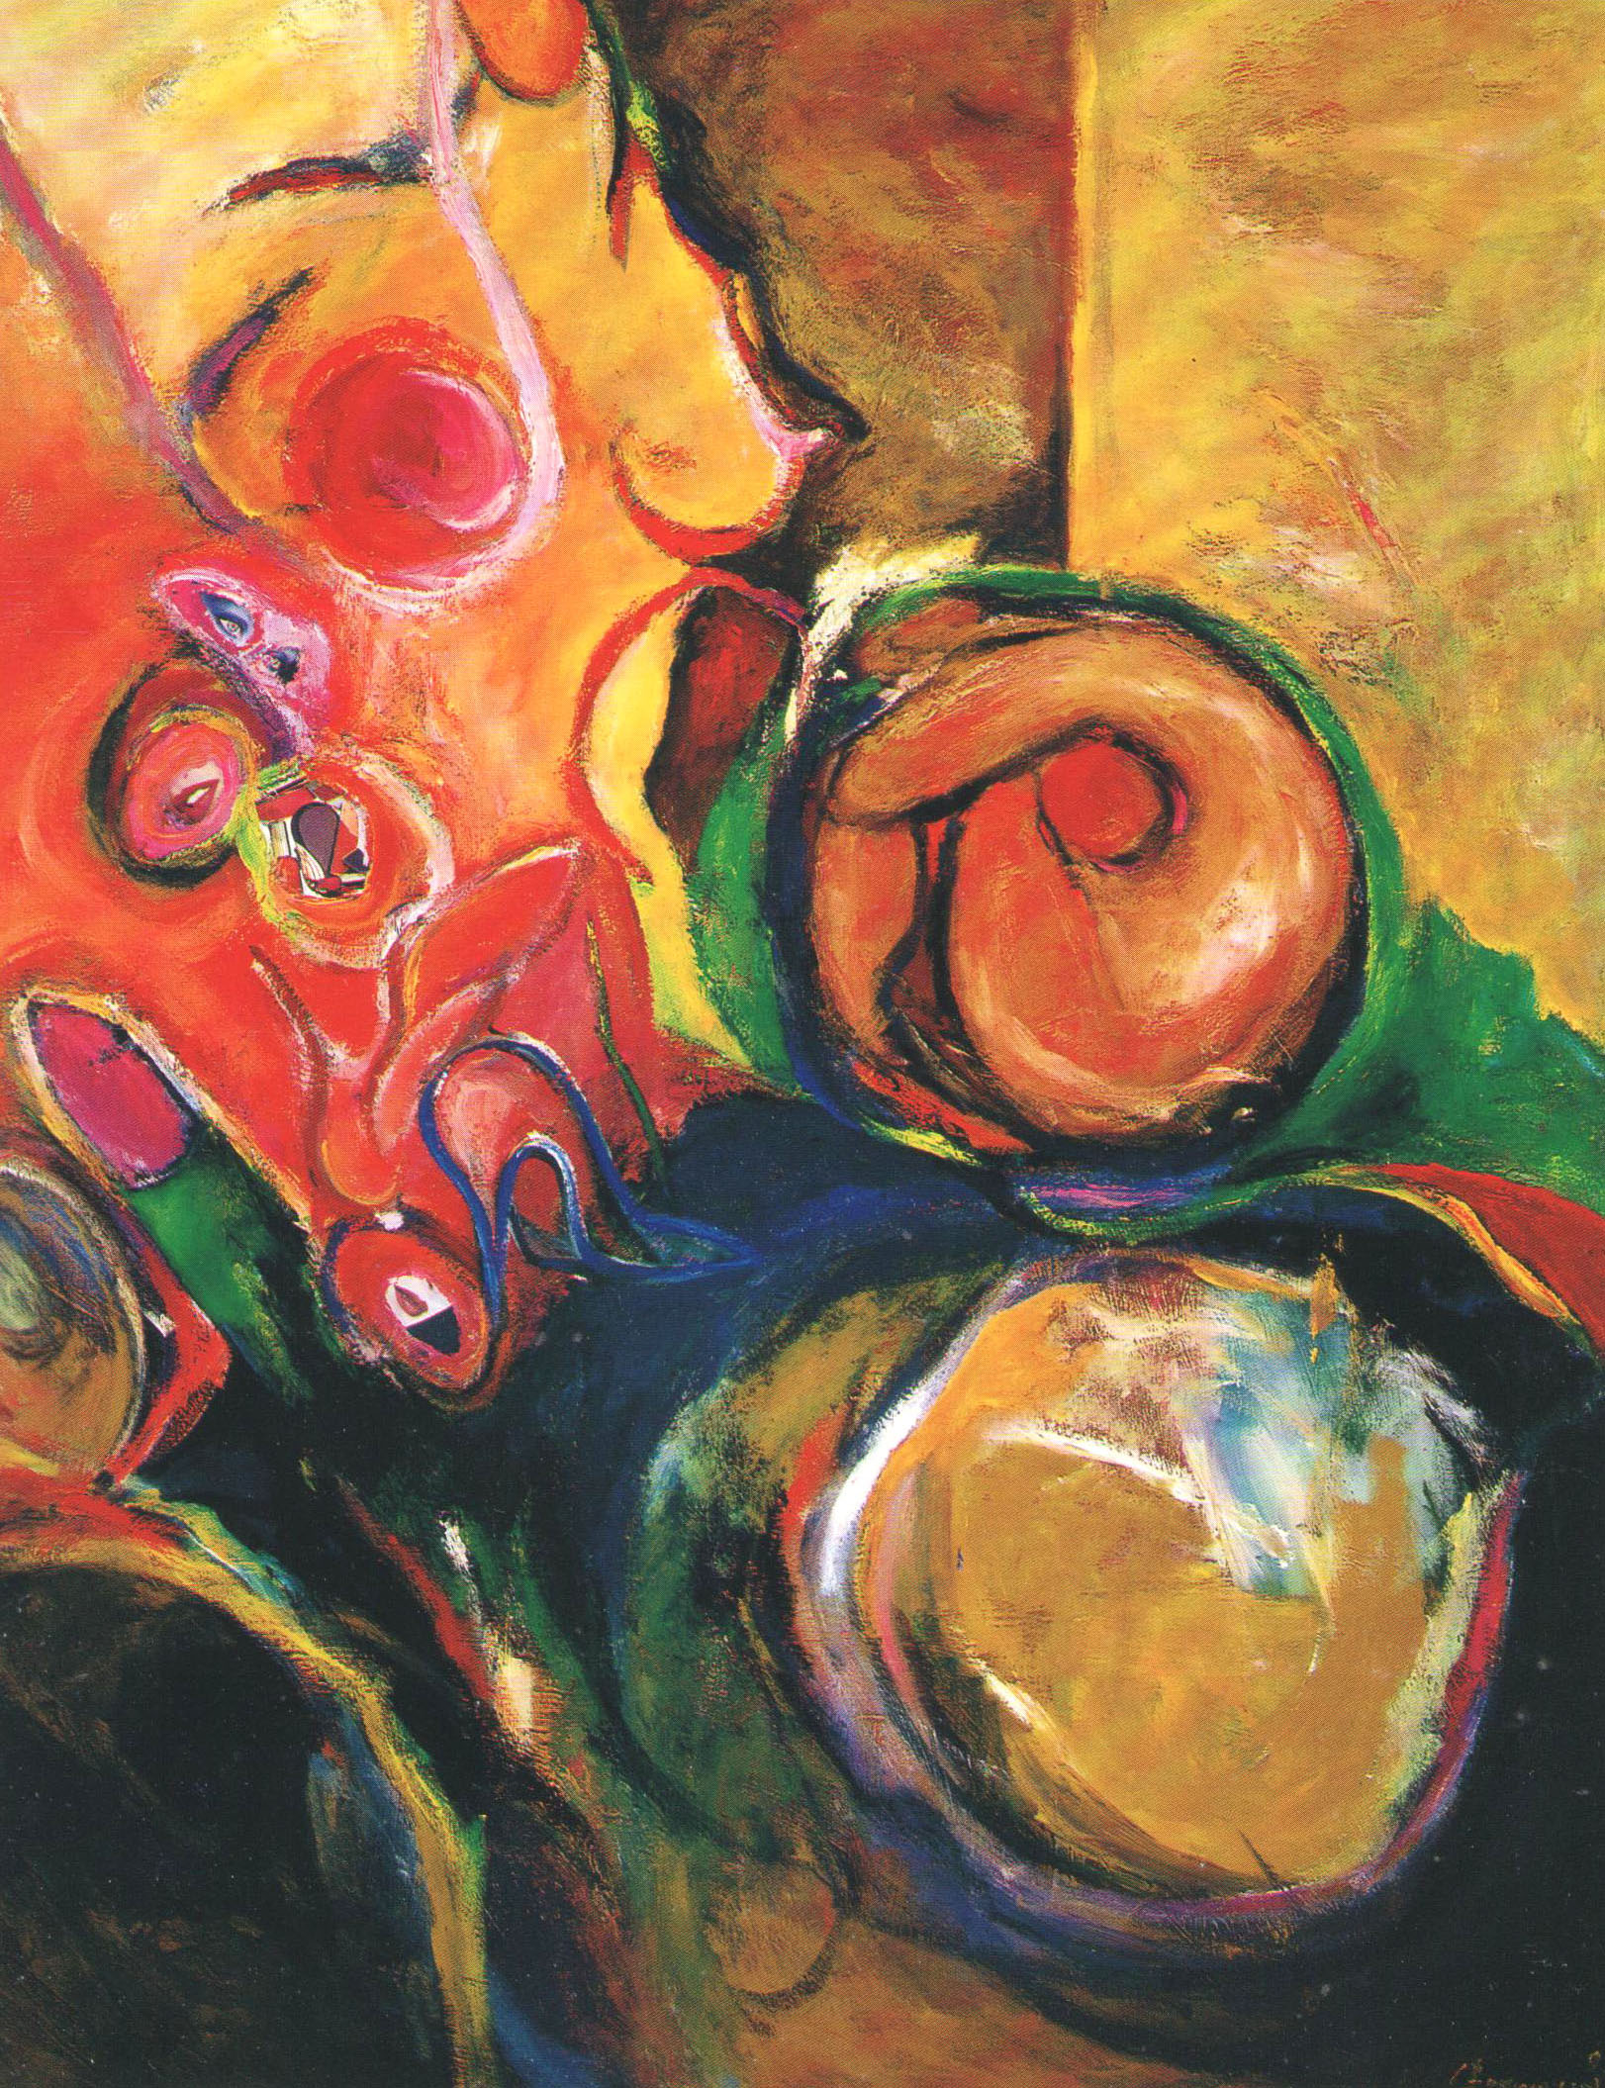
文明誘惑系列
The Temptation Series (1992)
http://www.linpeychwen.org/the-temptation-series1992
油畫
130X162cm/100F

Slide 10
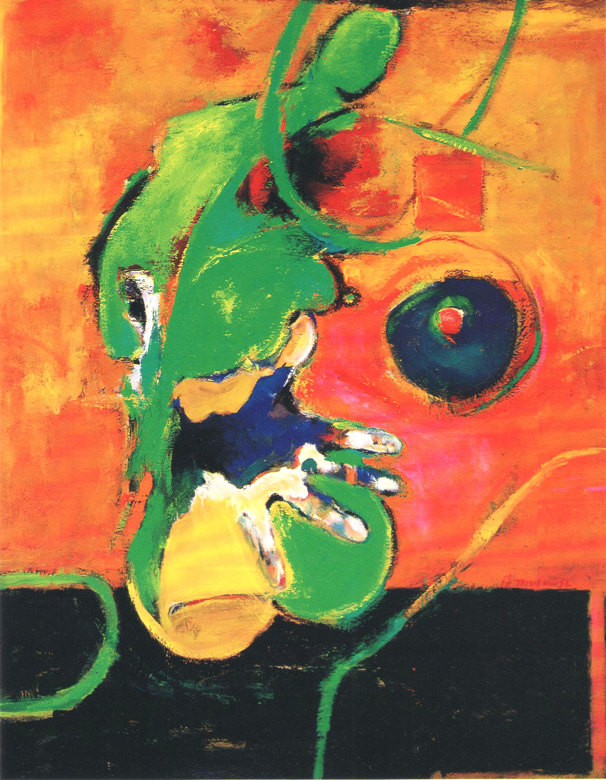
生命圖像系列
The Image of Life(1992)
http://www.linpeychwen.org/the-image-of-life1992/
油畫
91X117cm/50F

Slide 11
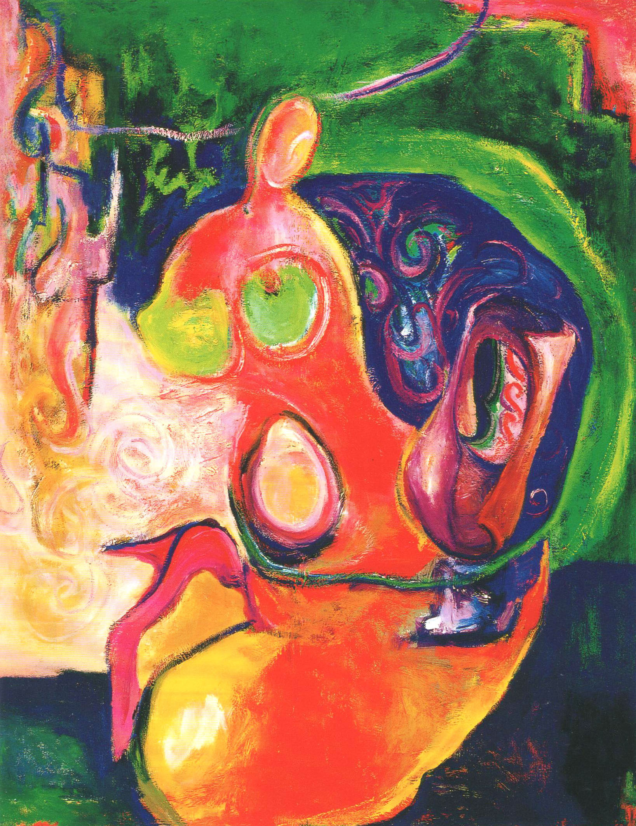
傳統與現代
Tradition to Modern(1993)
http://www.linpeychwen.org/tradition-to-modern1993/
油畫
91X117cm/50F

Slide 12
Art Statement
Pey-Chwen Lin’s Art Statement of Patriarchal Decontruction
Hsieh Hung-Chun (professor of National Hsinchu Teachers College/artist)
Lin Pey Chwen in her youth, with most of her works in abstract paintings. She explored in abstract, seeing through some issues, rather like talking to herself, with stronger self dialogue nature. In 1989, after completing her MA degree from USA, her works after returning to Taiwan started to appear one "egg-shaped" entity by another. It seems to be a forming, hidden, and soon breaking through "energy" while confronting feminine perplexity. Therefore, she addressed that period as "Chrysalis Period". From then on, her abstract paintings gradually showed substantial forms, "egg-shaped chrysalis" some turning to high-heel shoes, fingernail polish, lipstick, female body, breast, etc. At that time, she entered into the feminine consciousness for exploration with female issues.
She was awarded scholarship by Australia government and received a Doctor of Creative arts in the University of Wollongong. During this period, she continued her studies on female subjects, and published many articles and essays to explore female art and feminine consciousness. In 1995, she had a solo exhibition in Taipei Fine Art Museum, presenting the "Antithesis and Intertext-The Issue of Women's Position" series. At this time, Lin Pey Chwen had deeper thought about feminine issue about Taiwan, and her creation has changed from this. Starting from some personal issues cultivated and perceived in Chrysalis Period, till absorption of more comprehensive knowledge in her advanced study period to Australia, she has founded more profound theoretical basis. The problems under her exploration in this period turned to be bolder and bolder. And she exposed herself more and more (from plane, semi-substantial painting, gradually turning to mass medium, and the installation works), she confidently expressed the problems.
The works of Lin Pey Chwen in this period gradually dealt more with installation. On the other hand, her concern about female issues are not only restricted to her own, but also extended to female problems to broader issue such as the issues of politics, culture and humanity. In 1997 and 1998, during the "228 Art Inviting Exhibition", her works were talking for the females in 228 Incident. In 1997, her "Black Wall, Inside and Outside of Window" demonstrated the survived family members of 228 victims (she stood in the position of wife and children). In the window, people have been under surveillance for more than 40 years. Today, they have to face the pain of "being peeped". In 1998, she made "228 Trophy", using suspicious and ironic attitude to face 228 Incident, the product of war under ruling party.
On Women's Day of March 8, 1998, she was invited by Taipei City Government to create a large piece of installation work for "National Female Assembly", "From Sorrow to Action - Taiwan Women Movement Turning Point"; this work attempts to mourn Peng Wan-Ru, Pai Hsiao-Yen and numerous females passing through sorrow, and expects to produce "force" out of "action" as the theme installation art. By means of such natural materials as straw, rope, wood, etc., they combine to become safety nests all over the community, symbolizing the unification of female force, leading people to a safety belt where people and people, men and women, men and the nature get alone harmoniously in peace.

Slide 13
Just like what said by Lin Pey Chwen, as she clarifies a problem, it is required to express works in substantial form. Yet now she expresses it in an initiative manner by standing out, no more like abstract sense and self description in early period. In Art Space of National Hsinchu Teachers College, Lin Pey Chwen's "Maze"
installation work further starts from human concern in a more comprehensive manner, to explore the "reality” and "falsehood" problems in humanity and life.
Hsieh Hung-Chun (professor of National Hsinchu Teachers College/artist)

Slide 14
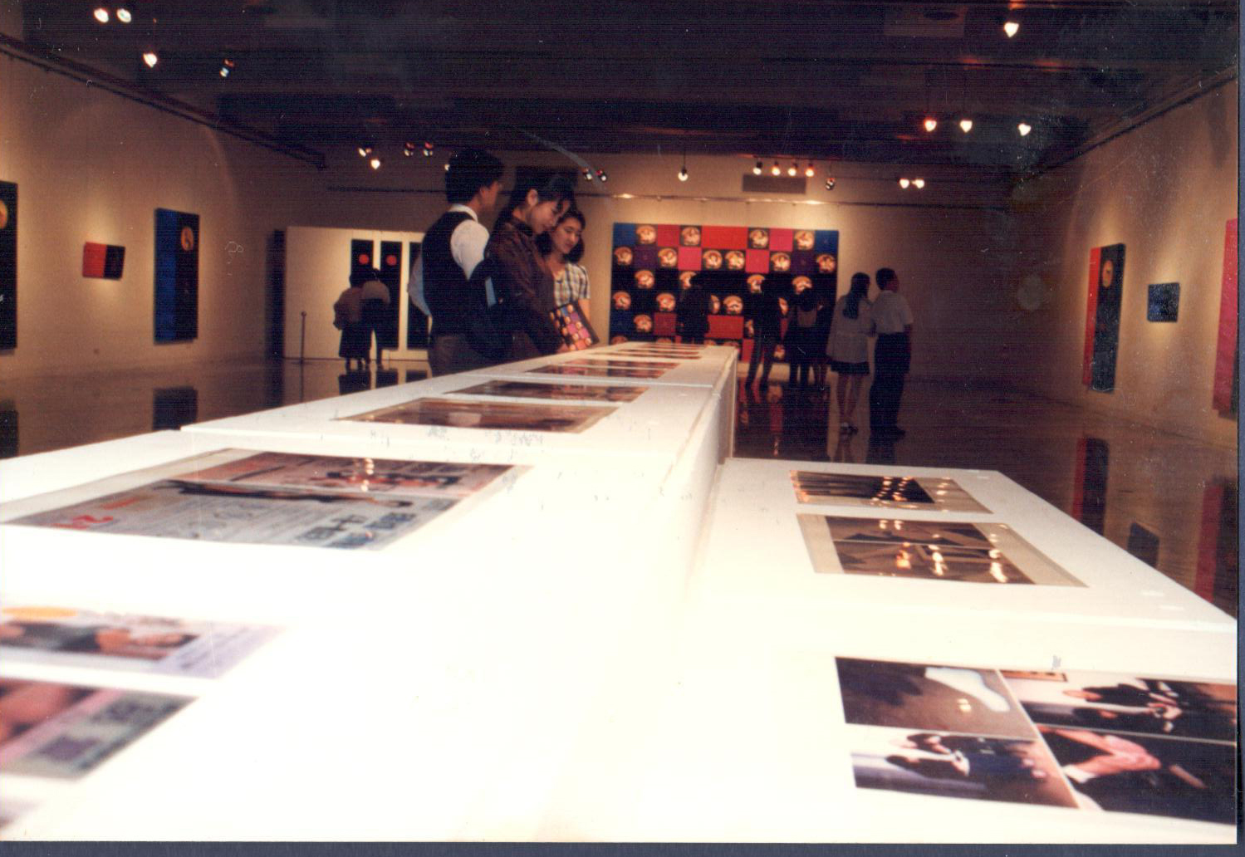
相對說話系列
Antithesis and Intertext (1995)
http://www.linpeychwen.org/antithesis-and-intertex-1995/
Serigraph、Oil Pigment、Canvas、Rayon、Embroidery
270cmx400cmx10cm
The interesting facade of "Antithesis and Intertext-The Issue of Women's Position" is， the artist uses complicated and multiple contrast method to construct the specific historical and cultural features formed by female physical consciousness of Taiwan. The medium of the work displays both oil painting and embroidery in painting fabric concurrently， forming the first layer of contrast relationship; oil painting image and fan combination form another layer of contrast; while Chinese ancient lady’s picture and golden-hair beauties form the third layer of contrast relationship. The artist uses the so called traditional Chinese and occidental medium material， language and historical scene in contrast relationship to construe the time and space in Taiwan of female consciousness.
Indeed， the common features of females indifferent communities ， mainly lie in their similar” group position" called” woman" or "female" laid by their society; yet this ” woman " or ” female ” content differs in terms of history and culture. Even though in the global ， network-oriented trend ， within the art scenario where the boundary between "China" and ” occidental community ” has been gradually ambiguous， to re-create the idioms of traditional boundary between ” China" and ” occidental community" may not be proper， yet it is a primary trial to resist the tremendous imperialistic colonial power penetration/control entity in form and system.
Exhibitions
“1996 Taipei Biennial: The Quest For Identity”， Taipei Fine Arts Museum， Taipei， Taiwan ,1995
“Collections Asian Art”， Australia Long Gallery， Australia ,1996
“Contemporary Art in Taiwan”， Fong Chia Museum of Art， Taipei ,2003

Slide 15
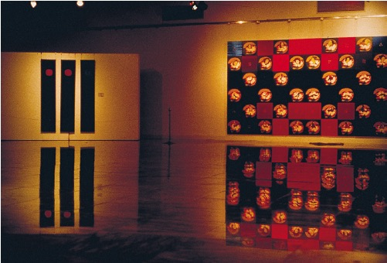
相對說話系列 I
Antithesis and Intertext I (1995)
http://www.linpeychwen.org/antithesis-and-intertex-1995/
Serigraph、Oil Pigment、Canvas、Rayon、Embroidery
270cmx400cmx10cm

Slide 16
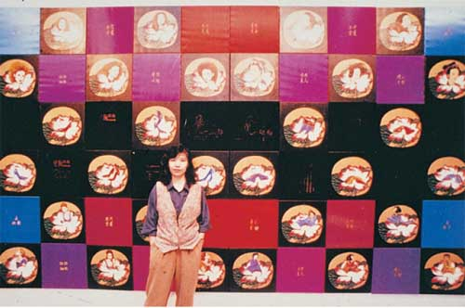
相對說話系列 II
Antithesis and Intertext II (1995)
http://www.linpeychwen.org/antithesis-and-intertex-1995/
Serigraph、Oil Pigment、Canvas、Rayon、Embroidery
120cm x 40cm x 5cm

Slide 17
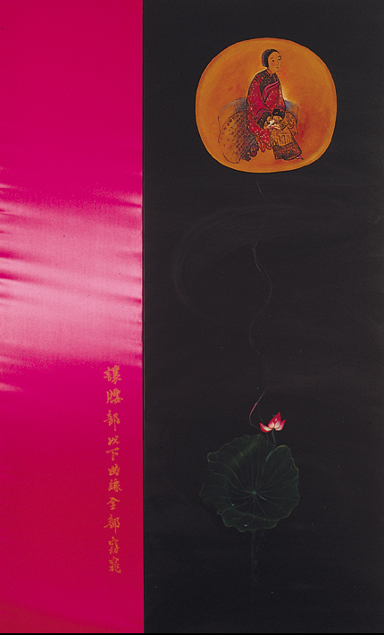
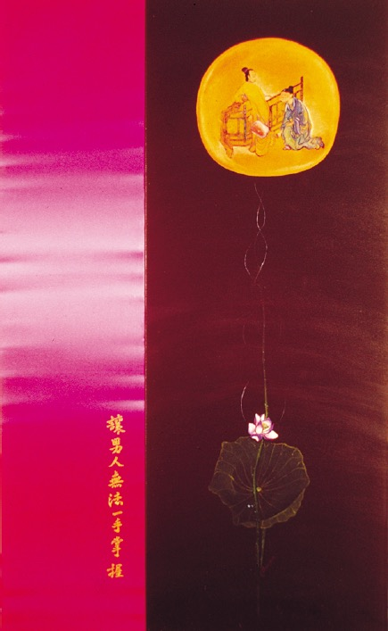
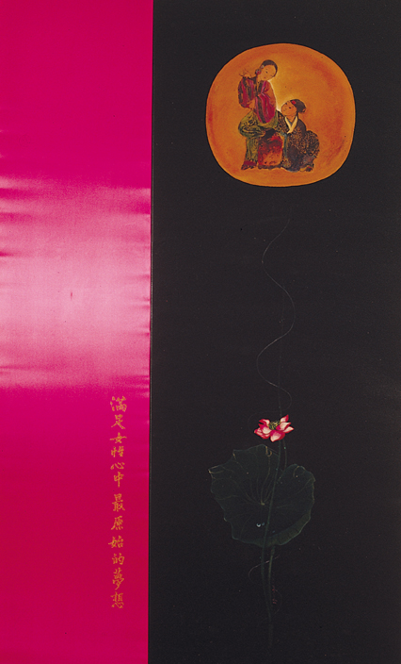
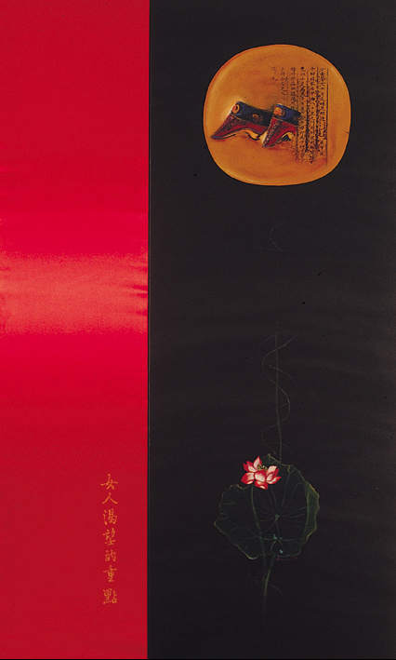
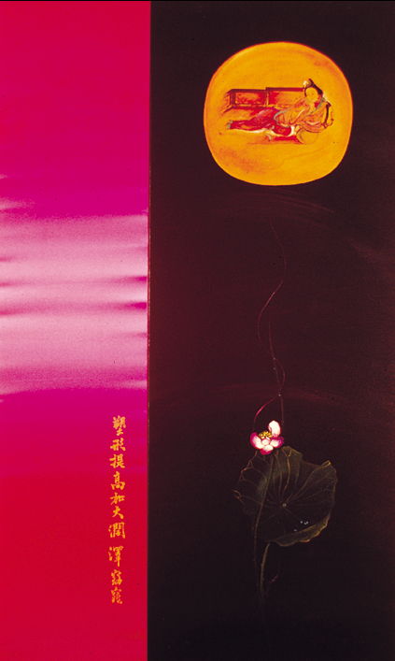
相對說話系列 III
Antithesis and Intertext III (1995)
http://www.linpeychwen.org/antithesis-and-intertex-1995/
Serigraph、Oil Pigment、Canvas、Rayon、Embroidery
250cm x 90cm x 10cm

Slide 18
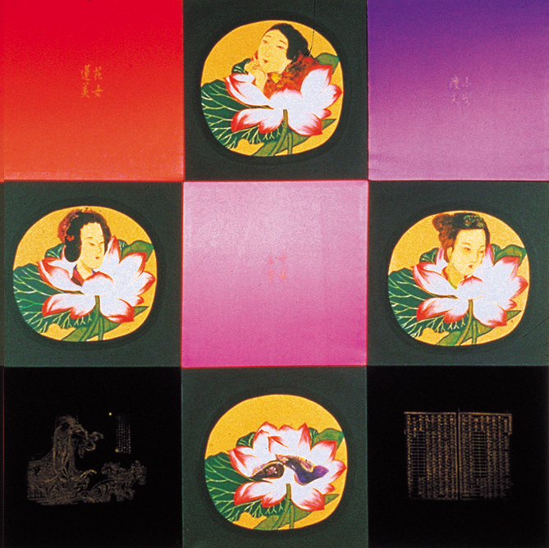
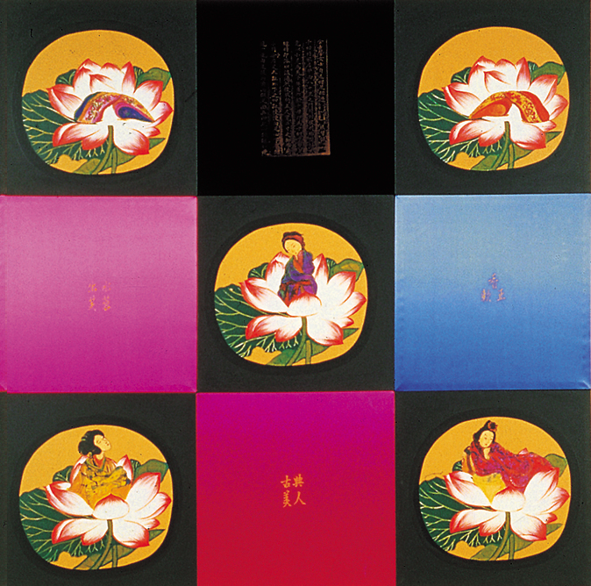
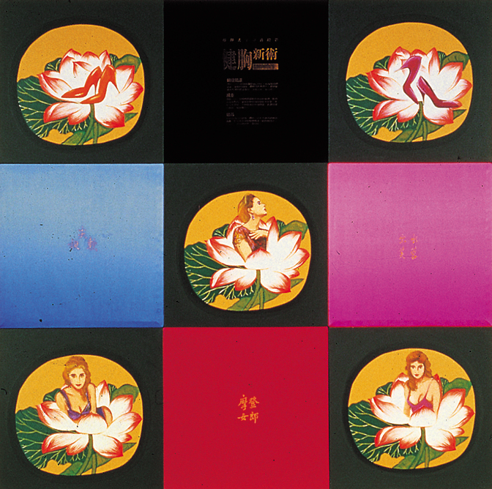
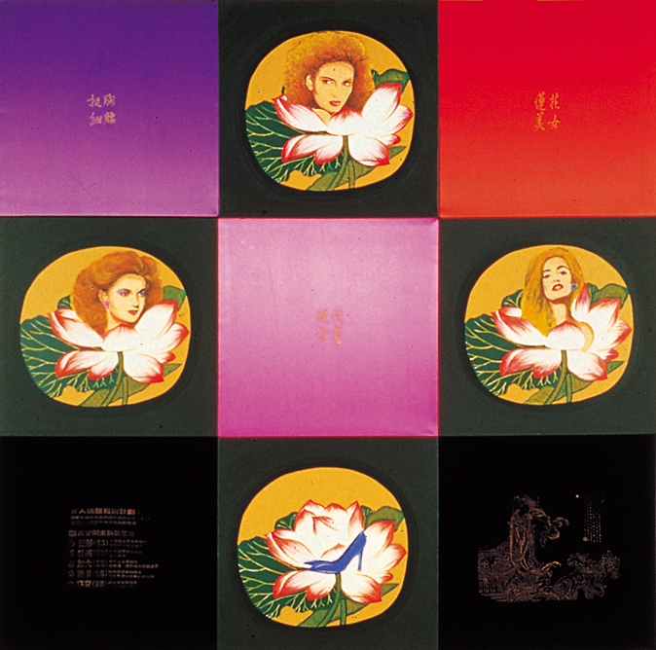
相對說話系列 III
Antithesis and Intertext III (1995)
http://www.linpeychwen.org/antithesis-and-intertex-1995/
絹印、油料、畫布、人造絲、電動繡
250cm x 90cm x 10cm

Slide 19
黑牆、窗裡與窗外
Black Wall Inside and
Outside of Windows (1997)
http://www.linpeychwen.org/black-wall-and-inside-out-of-window-1997
Artificial flowers、Blind Window、Serigraph、Chemical Corrosive、Lead Plate
450cm X 300cm X 250cm
Like an ordinary or even graceful living room， decorated by dried flower ， yet hiding the anonymous fear， sadness and extremely contradictory complex of the female main character . From the psychological level， in fact， this is a space nearly without window and nor exterior area. Is what locked inside family tragedy beyond imagination and oblivion on purpose? Sorrow and hatred hidden in mind which one dares not disclose to others? Is it because peeping has been going on outside the window that the decorative item without life has to be feigned to cover the sacrifice gesture and sorrow， hatred and anger ? Is it because escape of the past jointly seals the life passion pointing to the future? Should one disclose the old wound at once to release aged dirty blood and walk out of darkness? The window after all is gradually opened. It is opened concurrently to the past and the future. One bundle of red flowers timidly raises through the beautiful yet cold silver mesh stand. Her work conveys delicate spiritual struggle of a wife to a victim， depicting her sorrow and endless love.
*The 228 Incident broadly refers to various events starting in late February， 1947， culminating in the systematic killing of disputed number of the local elite， known and potential dissidents， and other Taiwanese by the Republic of China army under Chiang Kai-shek's Chinese Nationalist Party.
Exhibitions
“Sadness Transformed—228 Commemorative Exhibition”， Taipei Fine Arts Museum， Taipei, 1997

Slide 20
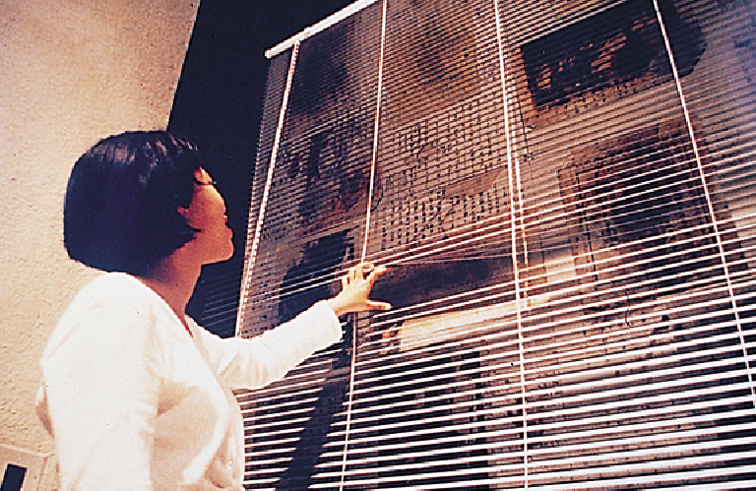

Slide 21
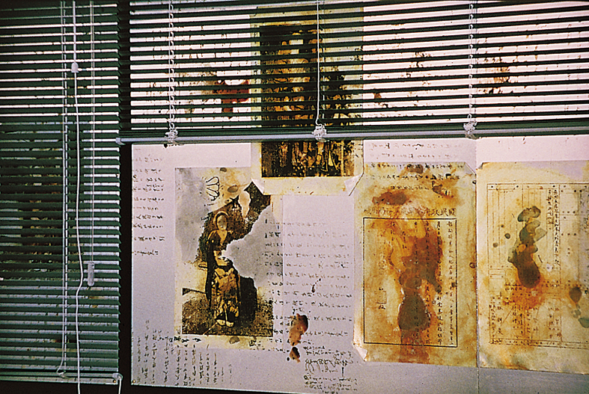
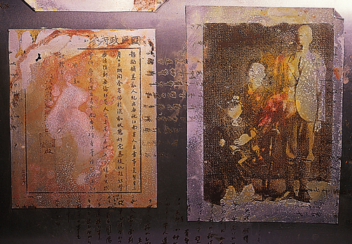

Slide 22
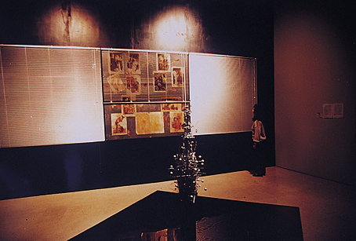
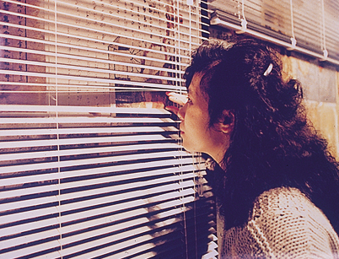

Slide 23
向造成228台灣歷史大悲劇的當局者致意
Regards to the Authorities
Hiding the Event (1998)
Cup、Wood Base、Red Carpet
1500cm X 150cm X 180cm
Lin Pey Chwen applies a kind of satire manner， aligns rows of trophy at the entrance of the exhibition site， such cheap trophies with brilliant golden color are installed over some fine black stands， under which， a full red carpet is provided; in such trophies， various words are written “ Regards to the Authorities Hiding the Event " and” Regards to the Authorities Killing the Innocent"， etc. to criticize the Authorities have distorted the history of the 228 successfully.
Exhibitions
“Reflection and Reconsideration—228 Commemorative Exhibition”， Taipei Fine Arts Museum， Taipei , 1998

Slide 25
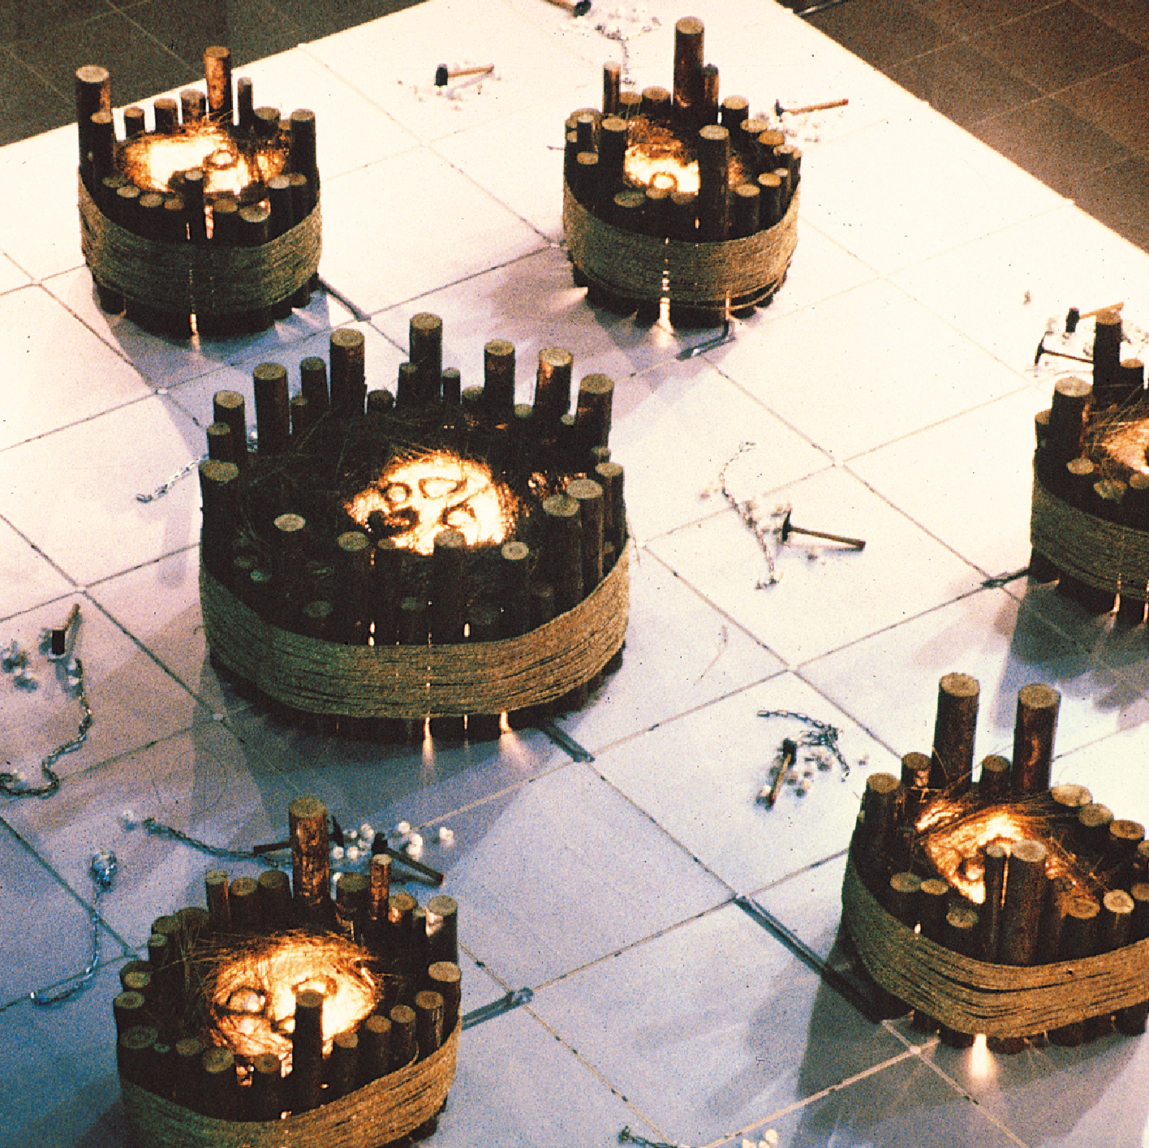
安全窩
Safety Nest (1998)
Mixed Media
240cmx240cm
Lin Pey Chwen, developing from abstract painting to hotabstractlikeinnervision of fluid human body in early period, later, gradually expressing such substantial female images ashigh-heelshoes,lipstick, breast, etc., and entering into the feminine consciousness for explorationwithselffemale issues. Though females struggledfrom bounded feet, yet in a commercial community, inevitably are bonded by "commercialized feminine aesthetics"again. Till years 95-96, she further confidently and attentively focused on exploration of feminine subjects, with expression form also turning to composite medium material and installation. Sheexpressed some rather strong criticism andirony. Inthe"Safety Nest" exhibited this time, inthesquarestainlesssteel platform center is one round-shaped nest encompassed by raw wood stick, laid with eggs pending to produce new lives, while outside it are scattered egg shells broken by a large hammer; inside/outside, life/death, tenderness/violence contrast is very clear. Besides, the declaration of unification of females to resist against the violent abuse of males is also extremely obvious.
Huang Hai-Hung (professor of Taipei Normal Teachers College/art critique/art curator)
Exhibitions
Taipei Fine Arts Museum/Taipei City Hall,1998

Slide 26
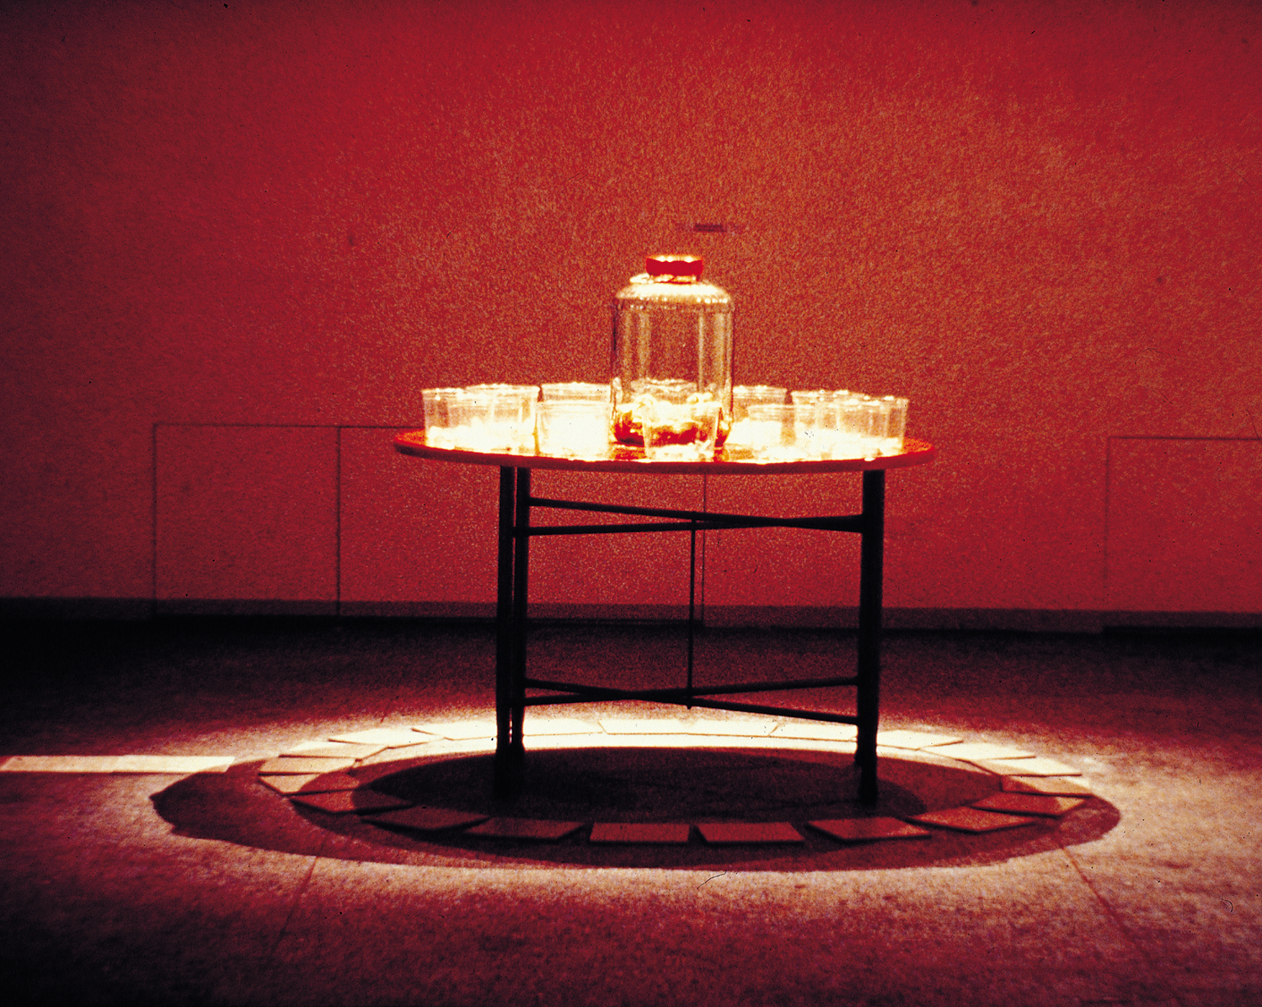
迷宮系列
Maze Series (1998)
Mixed Media
700cmx1800cm
"Maze" is just like a kind of game, and life is like a maze. In our life, we have faced many roads in front at all times, but we can only select one among them at once. No matter which road we take, we hope to successfully reach the destination.It is just like a case, we all know there is one paper strip in a fortune cookie, the text in the paper shows good luck or evil luck. Each person hopes to get the fortune cookie with good luck, yet not everyone is lucky.Lin Pey Chwen's work quotes the techniques of "dual opposition" and "reallocation" in post modernism, just like her past "Relative Words on Painting" series, "Inside Window? Outside Window?" series, till the present "Reality and Falsehood", Lin Pey Chwen alleges two opposite questions, from mutual contradiction and interaction, to seek further and more satisfactory answers.In her work, she also "reallocates" some symbols in the past art history (like urine container and garbage can), yet she applies such confirmed techniques by male mainstream art in a suspicious and ironic attitude, to explore and express her thinking. She thinks: in post modernism, suspicion occurs to the appearing schools, thoughts, symbols, etc. in past history, yet feminism, similarly, attempts to suspect all past history built by male mainstream standards, with suspicion and satire about the past historical standards, and, there is no constant standard ever lasting.
Hsieh Hung-Chun (professor of National Hsinchu Normal College/artist)
Exhibitions
Reality and Falsehood , National Hsin Chu Normal College Art Center, Shin Chu, Taiwan, 1996

Slide 27
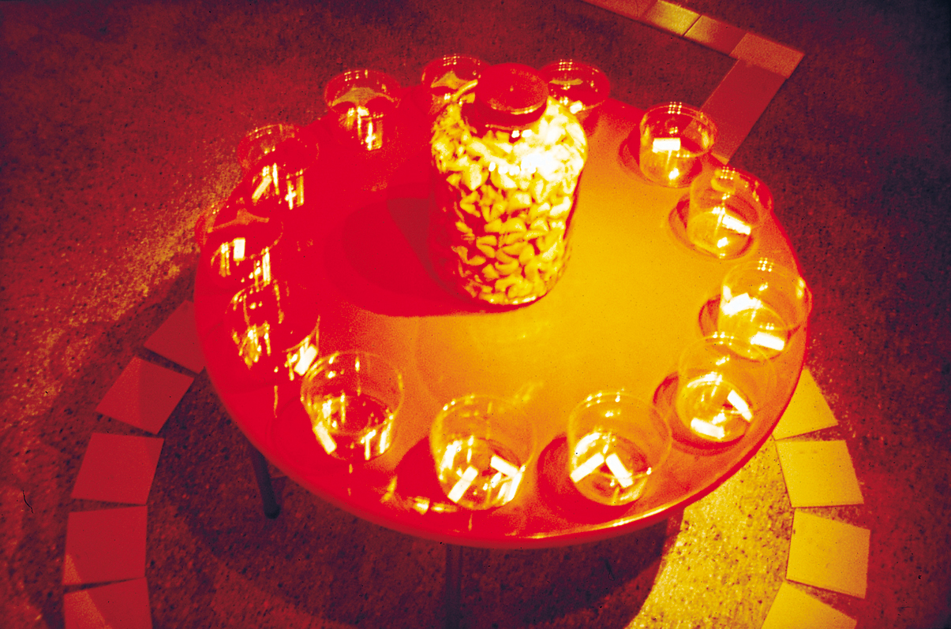
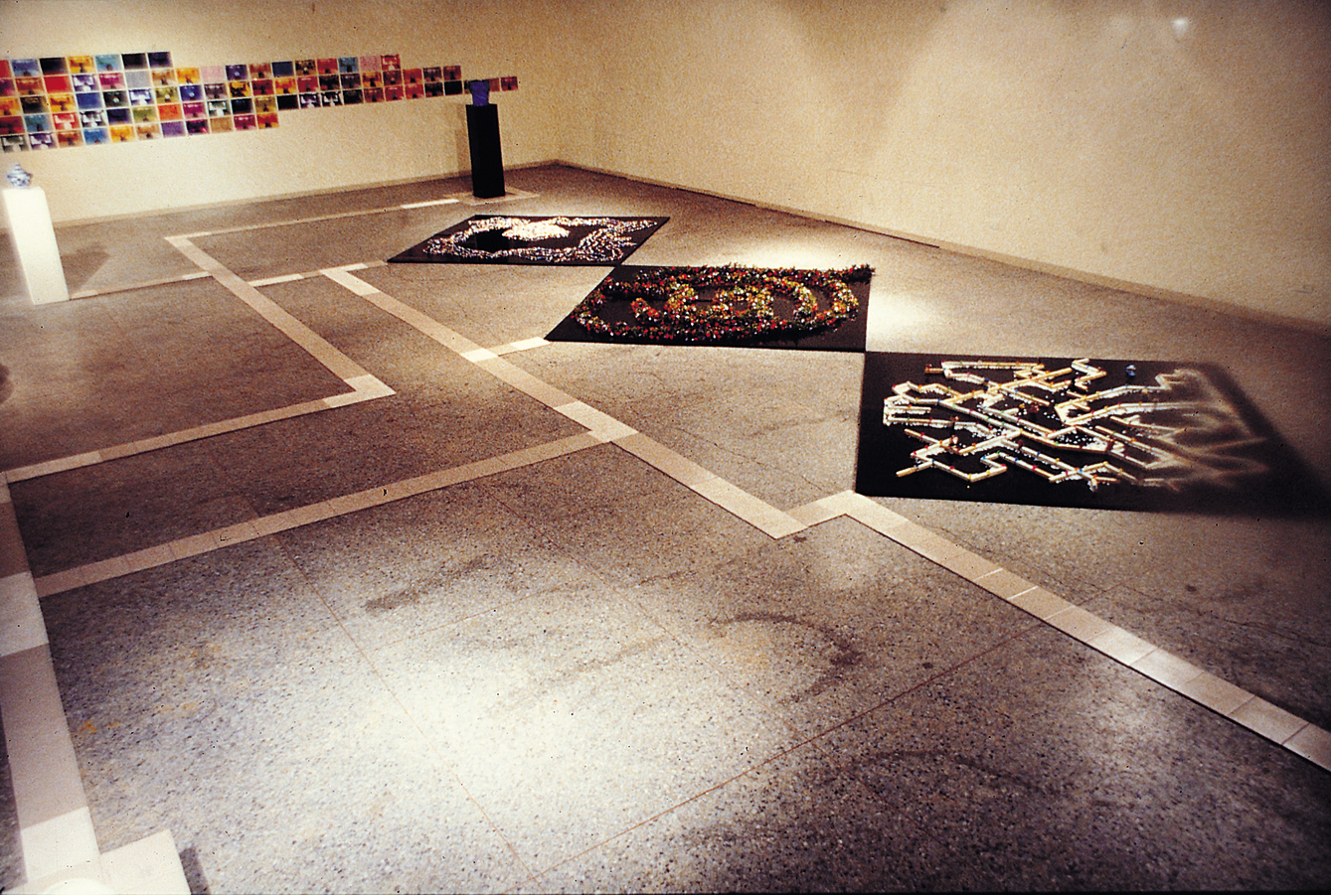

Slide 28
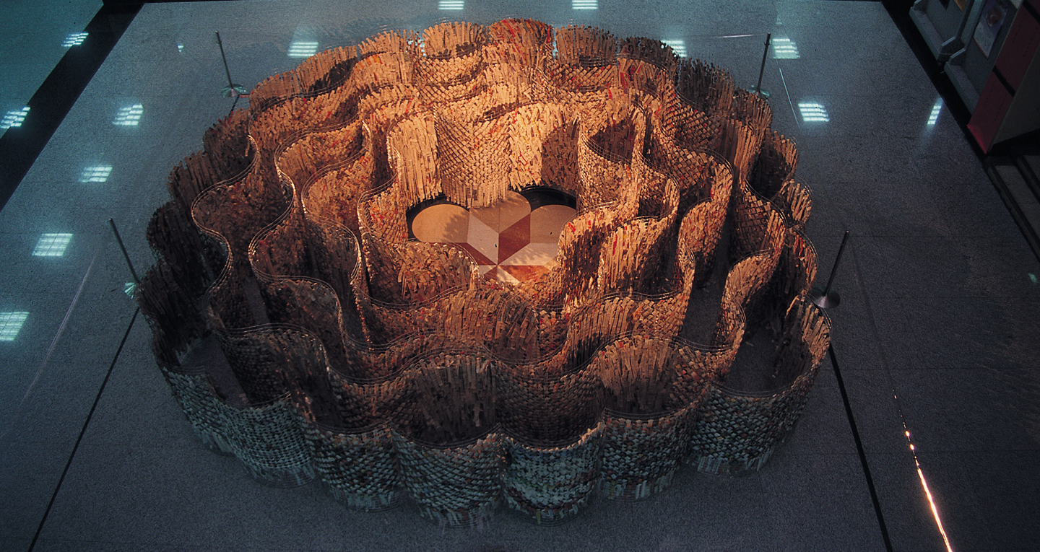
繁複與思源
Complexity and Thought Origin(1998)
Mixed Media
700cmx1800cm
This work attempts to mock the mutually influential relationship between social ideas. The artist uses iron mesh to construe units of cylindrical mesh stand, mainly attempting to express human thinking and behavioral pulse and structure. The numerous strip-shaped newspaper pieces over the mesh stand reflect the sketch of social image of Taiwan. These text and picture pieces record social chaos, yet also restate social issues to influence more comprehensive popular ideas. The artist suspects people in today to have no way of escaping from the circulating trap of media publicity, happening to repeatedly read the copy of human behavioral and thinking modes and without any self control.
Exhibitions
Taoyuan Cultural Center/ National Institute of the Arts

Slide 29
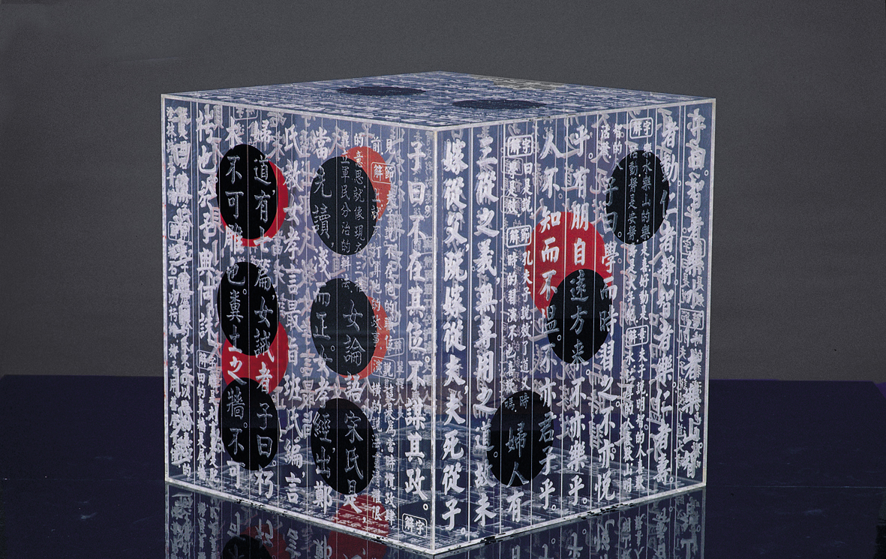
骰子
Dice(1998)
http://www.linpeychwen.org/dice-1998/
Acrylic Plate、 Laser Cutting、Digital Image Print
120cm x120cmx120cm
Lin Pey Chwen is very good at telling “word” through her “painting”. In 1995， her “Antithesis and Intertext” Series use the popular beauty advertising slogans in Taiwan vs. ancient bad practice of foot binding in China. In 1997， she used trophies and words in them to suspect the weak party and ruling authority of 228 Incident. The creation series are named” Regards to the Authorities Causing 228 Incident Historical Tragedy in Taiwan ". This year， her creation topic still deals with wordings and social satire issues. This time， she employs dice shape as a ” tool"， while text in form of the Four Books & Five Classics， the Three-Character Classic ， Woman Classics， and Woman Analects， etc. as major base.
Exhibitions
“Patriarchal Deconstruction”， National Taiwan Art Educational Art Museum， Taipei , 2000
“Motion with Time”， Gallerie Pierre Art， Taichung , 2005

Slide 31
經典之作
Classic Works (1998)
http://www.linpeychwen.org/classics-works-1998
Acrylic Plate、 Laser Cutting、Digital Image Print、Canvas
60cm x 60cm x 7 cm
Lin Pey-Chwen is very good at telling “word” through her “painting”. In 1995， her “Antithesis and Intertext” Series use the popular beauty advertising slogans in Taiwan vs. ancient bad practice of foot binding in China. In 1997， she used trophies and words in them to suspect the weak party and ruling authority of 228 Incident. The creation series are named” Regards to the Authorities Causing 228 Incident Historical Tragedy in Taiwan ". This year， her creation topic still deals with wordings and social satire issues. This time， she employs dice shape as a ” tool"， while text in form of the Four Books & Five Classics， the Three-Character Classic ， Woman Classics， and Woman Analects， etc. as major base.
Lin Pey-Chwen ， through plane or 3D acrylic as material ， prints phrases and sentences in ancient classics to such plane plates or 3D planes， then transfers printing the dice numbers to each facet ， making both words and dice number appear concurrently . The whole work in fact is an extremely paradox situation reading classics generally refers to self fulfillment as chips of soliciting fame， profit， and rank， or even a criminal mean. Therefore， dice becomes a symbol of speculation. Ancient classics further manifest the opposite relationship between both of them. It is an integral Lin Pey-Chwen’s creation mode， using the existing material to be converted to rather modern look.
Exhibitions
“Patriarchal Deconstruction”， National Taiwan Art Educational Art Museum， Taipei , 2000
“Motion with Time”， Gallerie Pierre Art， Taichung , 2005

Slide 33
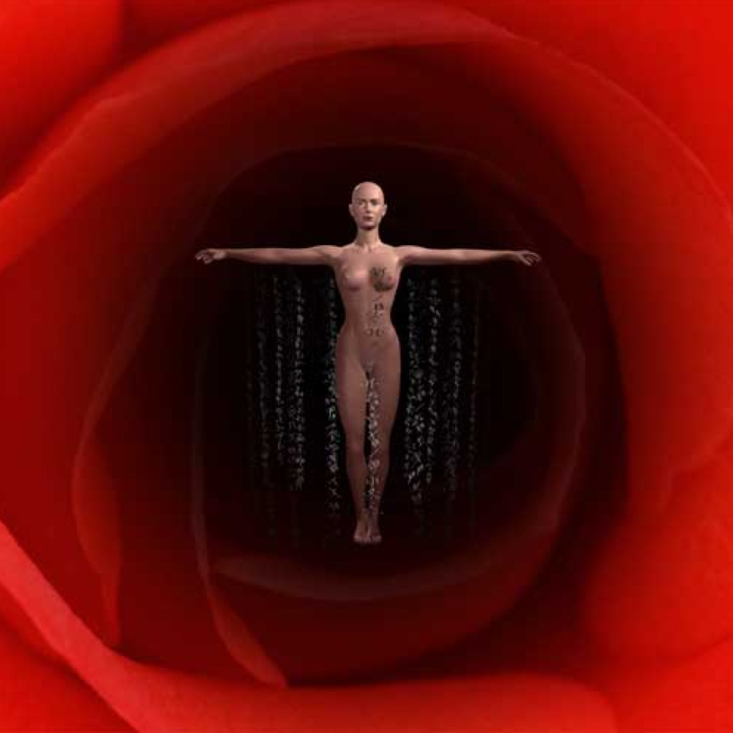
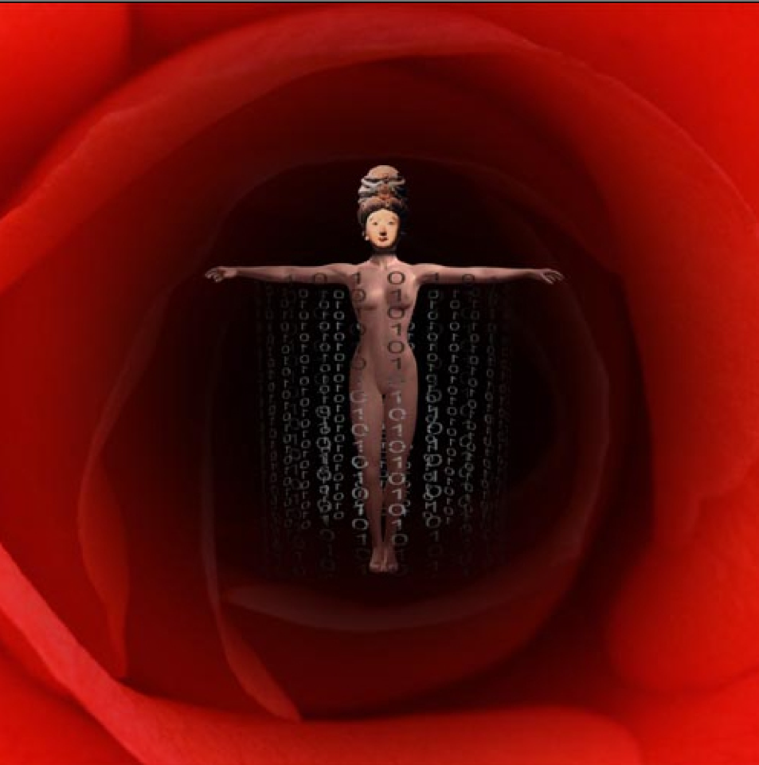
No Way Out (2000)
3D Animation
.

Slide 34
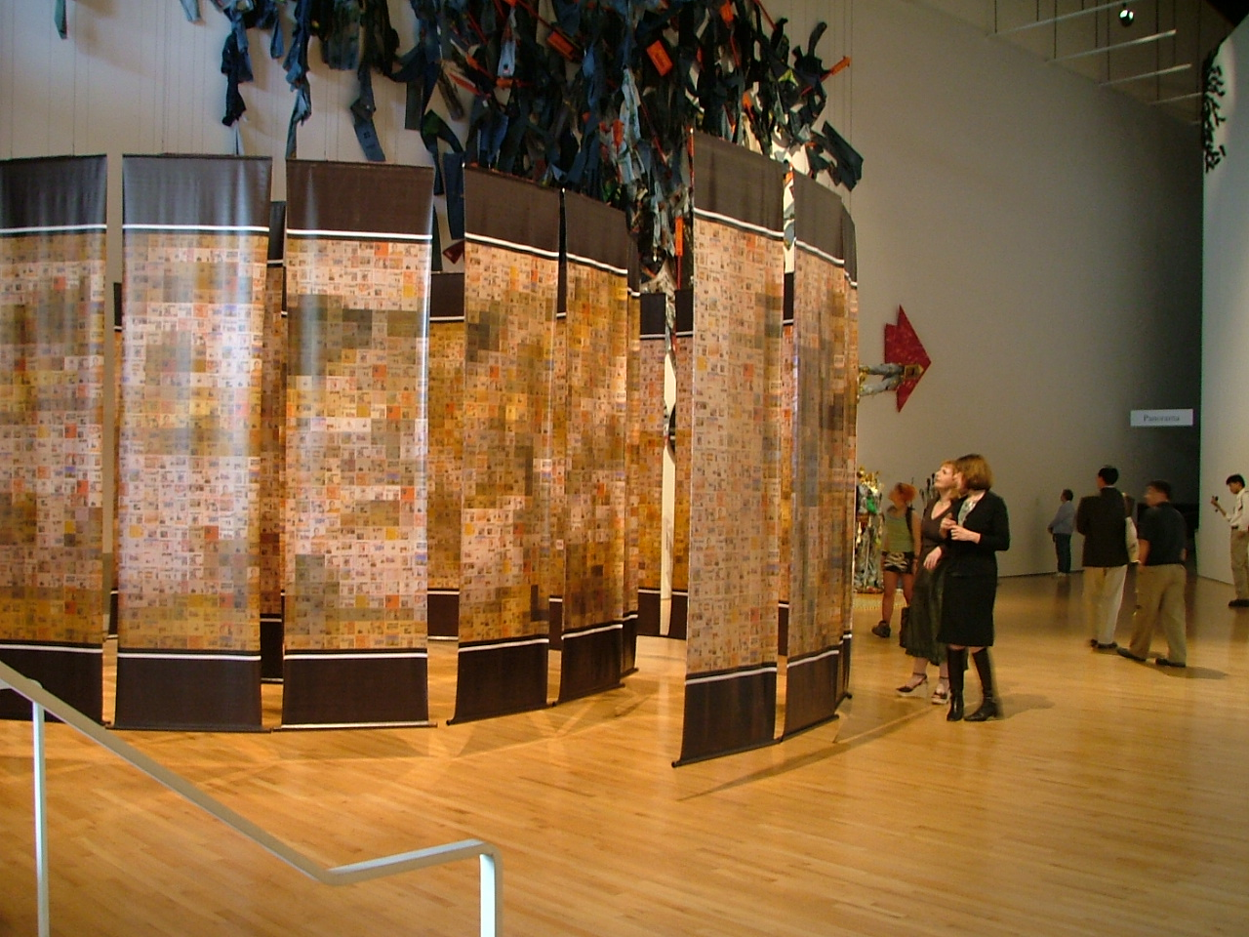
美麗人生
Beautiful Life (2009)
http://www.linpeychwen.org/beautiful-life-2009/
Digital Image Print、Plastic Plate、Wooden Shaft
300 x 90 cm x 32 Pieces
Headlines and advertisements from daily newspapers act as individual units in large， complex works that comment not only on events occurring in contemporary life， but also on thoughts， behaviors and emotions found in far ranging contexts. The vehicle of the press engages readers with social trends and myths that are laid bare by a challenging juxtaposition of images and text in my work. In this piece “Beautiful Life” I have recreated one of the most famous ink paintings in Chinese history， Along the River During the Ching-Ming Festival. As a three-dimensional whirlpool of recent newsclippings. When the newspaper-based configuration acting as a circulation system wherein the viewer is a affected and manipulated without her/his knowledge.
Exhibitions
“Nexus: Taiwan in Queens”， Queens Museum of Art， New York， USA,2004

Slide 35
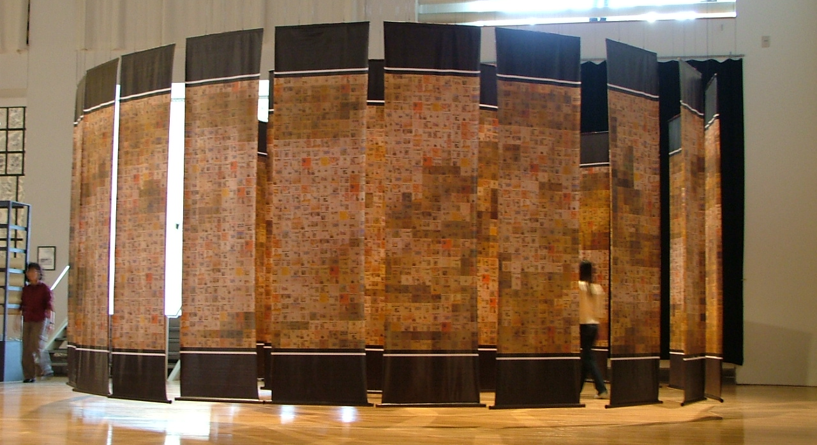

Slide 36
END

